Slide 1

iPhone CUI Capabilities
Anthony Zatika
Notes:
Hello, in today’s presentation I will be going over the iPhone’s capabilities when it comes to protecting CUI in a BYOD (Bring Your Own Device) workplace.

Slide 2
Agenda
iPhone
Definitions
Capabilities
Biggest Problems
What This Means
My Questions/Concerns
Topics For Next Week
Notes:
For the agenda today I will be addressing the iPhone, the definition I will be using for describing an iPhone, the protective CUI capabilities of the iPhone and whether they work by default or must be enabled, and lastly my questions/concerns.

Slide 3
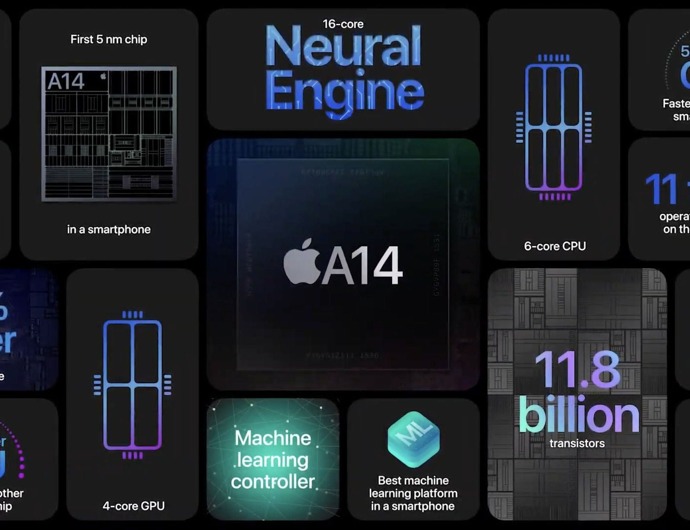


The iPhone
iPhones are mobile computing platforms.
iPhones carrying or interacting with CUI are a threat to National Security if unprotected.
iPhones are commonly used in BYOD (Bring Your Own Device) workplaces.
Notes:
One of the main reasons employees use iPhones in a BYOD workplace is because they are mobile computing platforms. This means that they have an array of features that make them as powerful as a laptop or Desktop. For instance, we can talk, message, answer emails, store data, and virtually accomplish anything as if we are using a laptop or Desktop. This means that iPhones are a threat to National Security if they are not protected.

Slide 4
The Definition
(i) has a small form factor such that it can easily be carried by a single individual
(ii) is designed to operate without a physical connection (e.g., wirelessly transmit or receive information)
(iii) possesses local, non-removable or removable data storage
(iv) includes a self-contained power source. Mobile devices may also include voice communication capabilities, on-board sensors that allow the devices to capture information, and/or built-in features for synchronizing local data with remote locations
The publication, “Guidelines for Managing the Security of Mobile Devices in the Enterprise” by Franklin, Howell, Sritapan, Souppaya, and Scarfone explains the definition of mobile computing platforms (iPhone).
Notes:
So, when I refer to an iPhone, there are some properties that make it useful in a BYOD workplace. An iPhone is a small form factor device that can be carried by a single individual. iPhones can operate wirelessly transmitting and receiving information. iPhones can also possess local or removable data storage. Lastly, iPhones can power themselves from a lithium battery, capture information through sensors and even communicate with others through a cellular signal. Of course, this means protecting iPhones in the workplace is just as important as a regular computer.

Slide 5
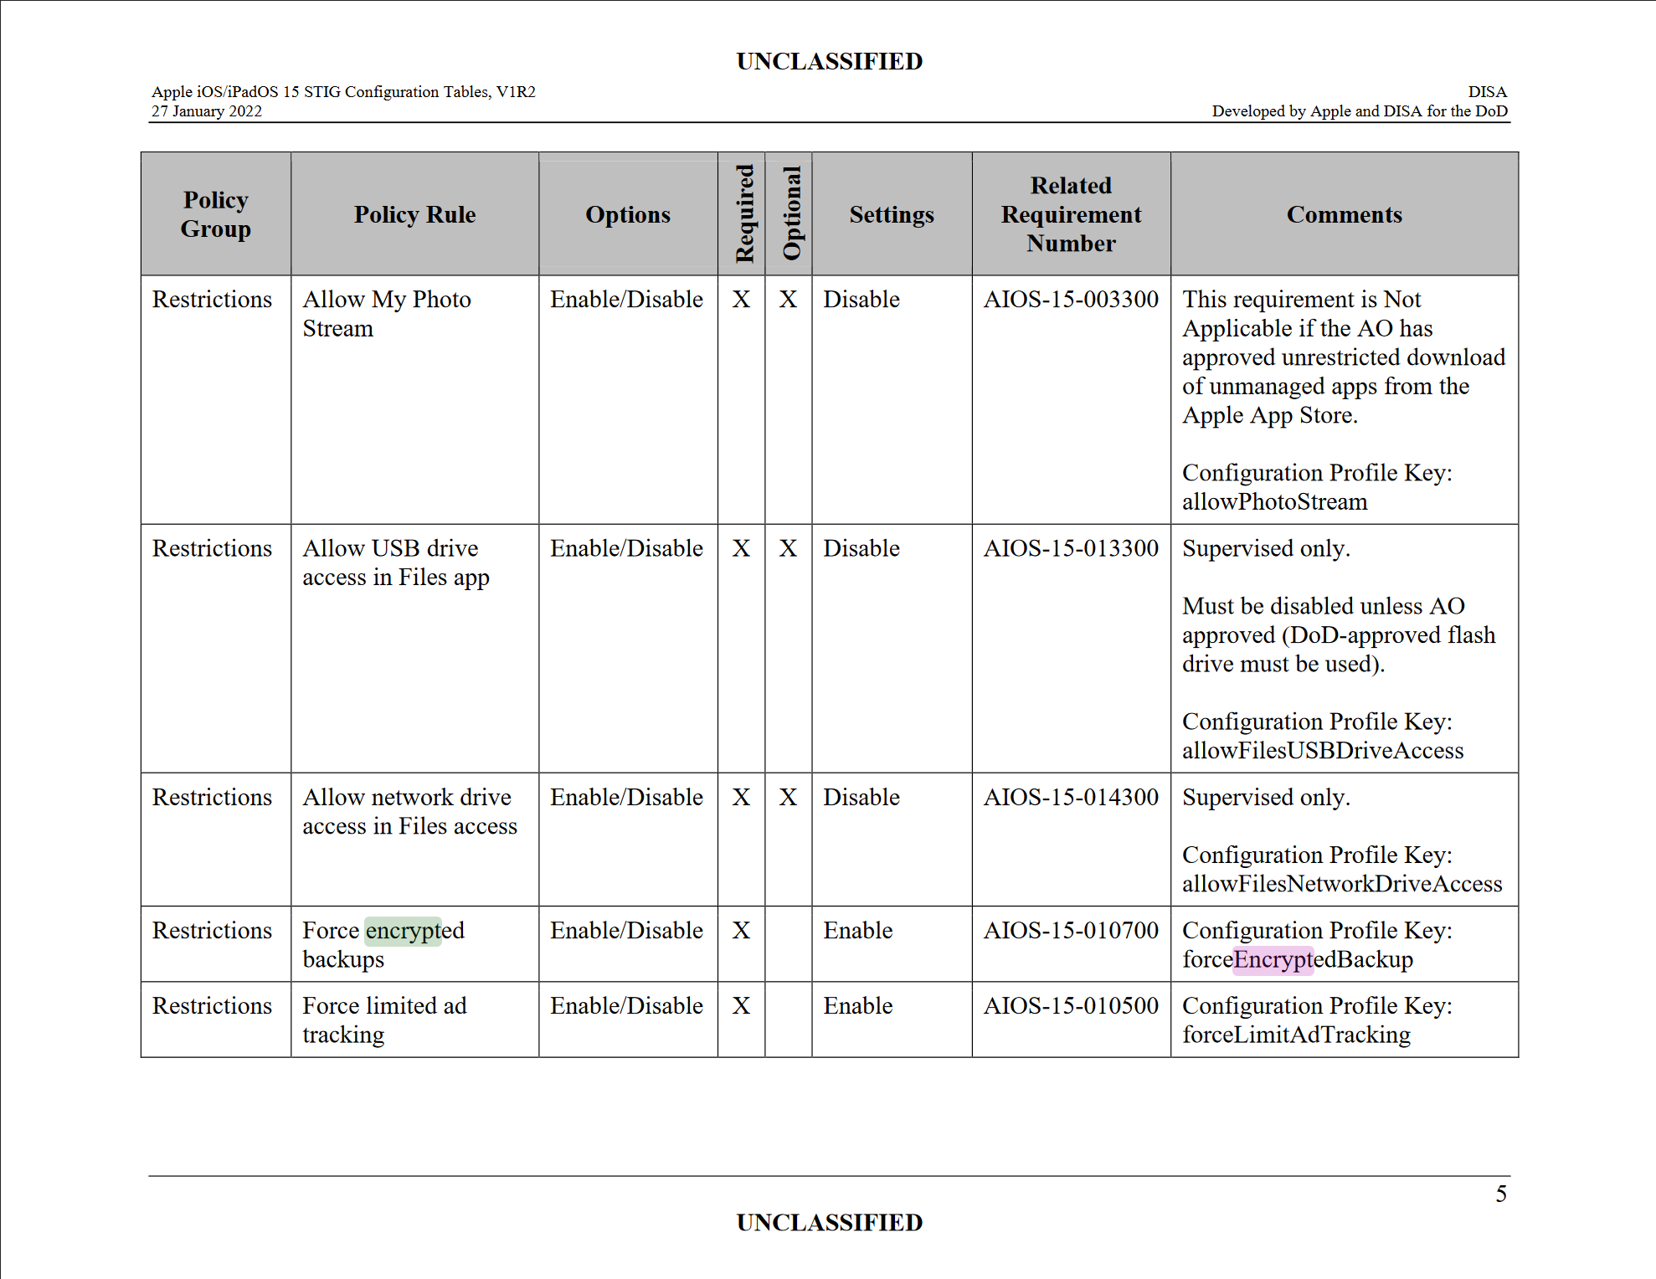
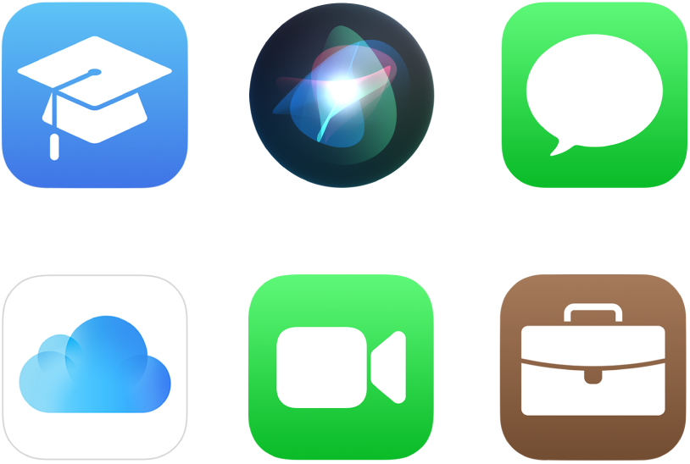
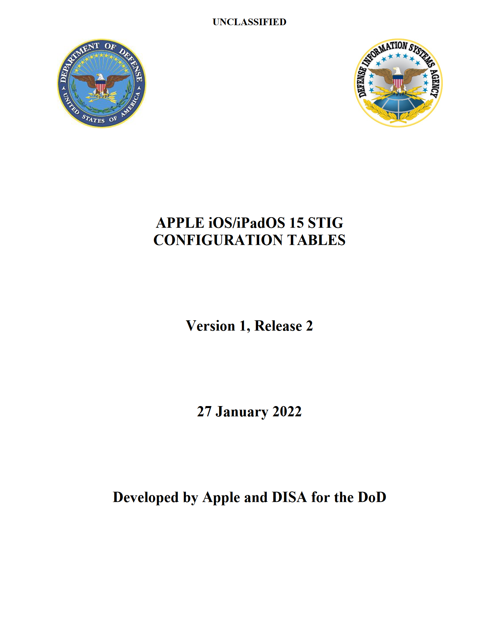
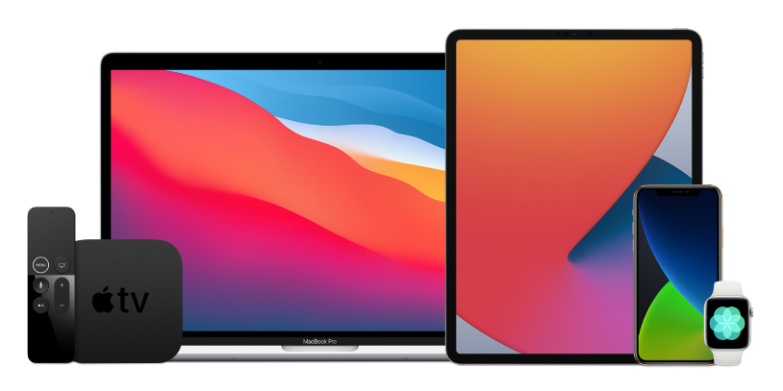
Capabilities
The iPhone is already built with security in mind.
The iPhone storage is encrypted by default.
Apple and DISA (Defense Information Systems Agency) release configuration tables about the iPhone (IOS 15) for security.
There are four areas that Apple focus on: Hardware, Software, Operating System, and Services.
The main point is that by default, all security controls are activated by default. This allows regular consumers to be as protected as possible as well.
Notes:
Luckily, Apple has worked with DISA (Defense Information Systems Agency) in designing their iPhones with security in mind. Apple and DISA specifically have created a myriad of security tables which outline each of the security controls that are enabled by default or can be disabled. For instance, in the image to the far left, you can see that there is an option to force encrypt backups so that if an attacker manages to steal a backup, they won’t be able to decrypt the data inside. Encrypting the iPhone’s storage is enabled by default. Apple makes sure that they cover their entire attack-vector base by employing security controls across their hardware, software, operating system and even the services that run on an iPhone. The main point is that Apple has collaborated with DISA to implement SP 800-179 NIST rules which is a comprehensive list of security controls to protect consumers and government agencies alike using their phones.

Slide 6
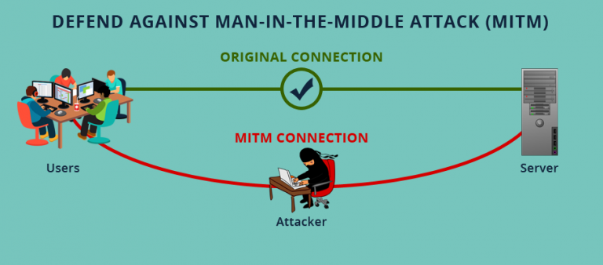
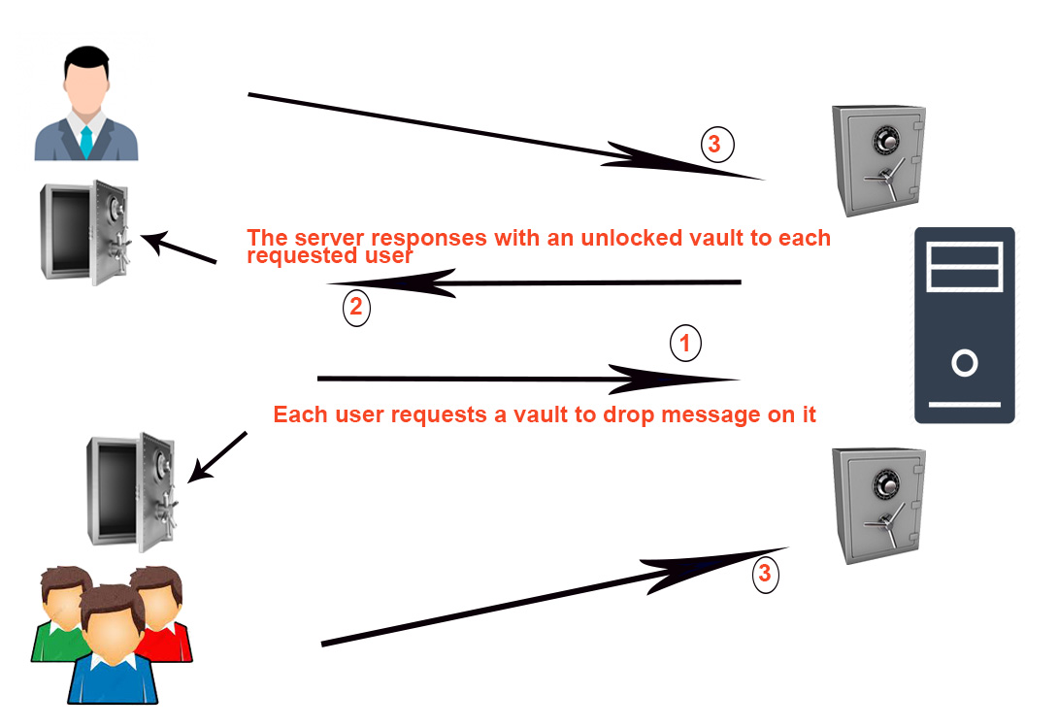
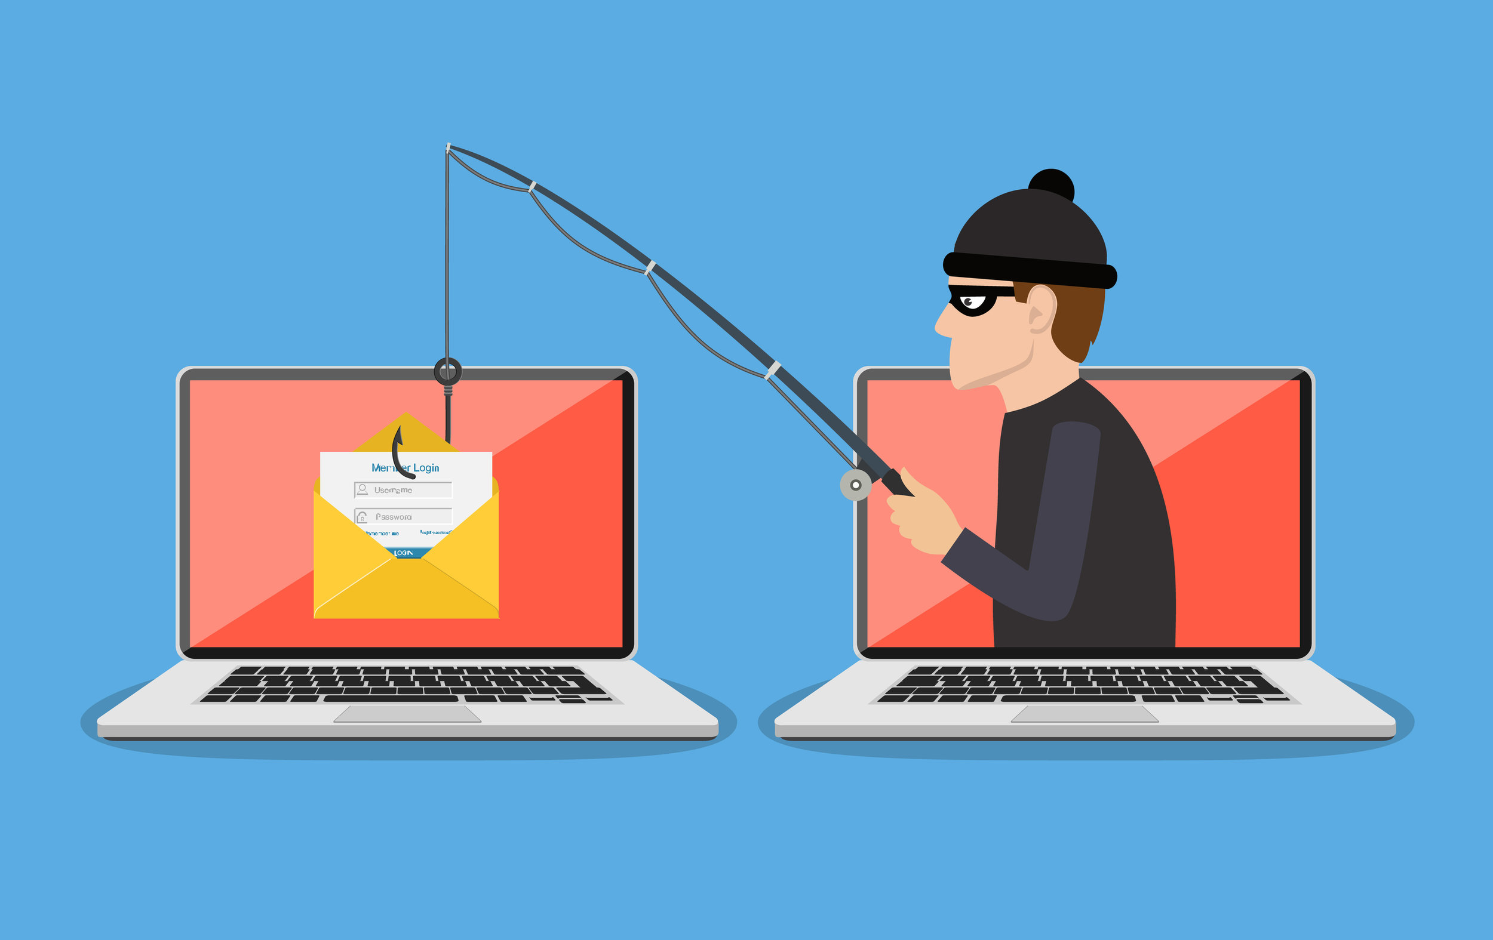
Biggest Problem
Apple keeps their IOS secret.
Software security tools are extremely hard to implement.
The big picture attack vectors: MITM, SSL downgrade attacks, and Phishing are dependent on network security.
Notes:
However, just because Apple includes a myriad of rules does not mean that they have covered every area. Primarily, Apple keeps their OS (IOS) secret. Therefore, security software is extremely hard to install and implement because companies/developers can’t create tools unless given special permission. This is the reason that there aren’t any antivirus on iPhones. This means that in the big picture, if a network at a company is not protected, attack vectors such as MITM attacks, SSL downgrade attacks and even phishing can compromise the iPhone and potentially steal CUI. The unfortunate part is that by Apple making their IOS very limited to developers, it can create unneeded security holes. If Apple would let developers install let's say Norton antivirus on an iPhone, the packet intercepting abilities of the antivirus would defeat any MITM attack or SSL downgrade attack.

Slide 7
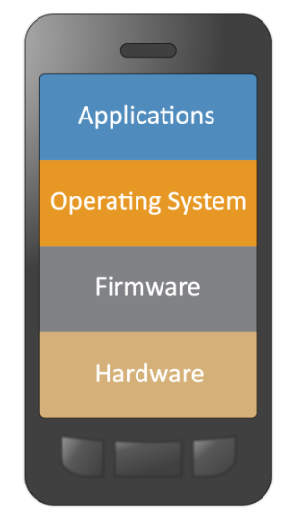
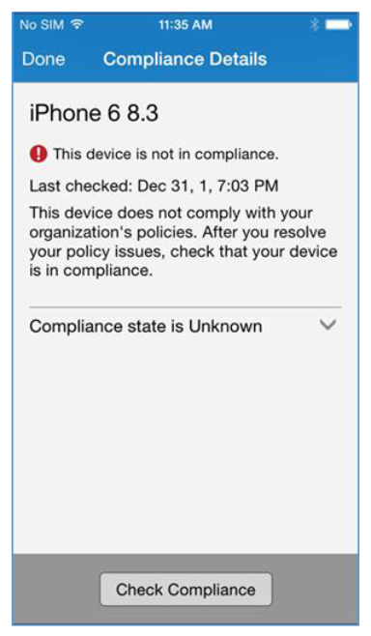
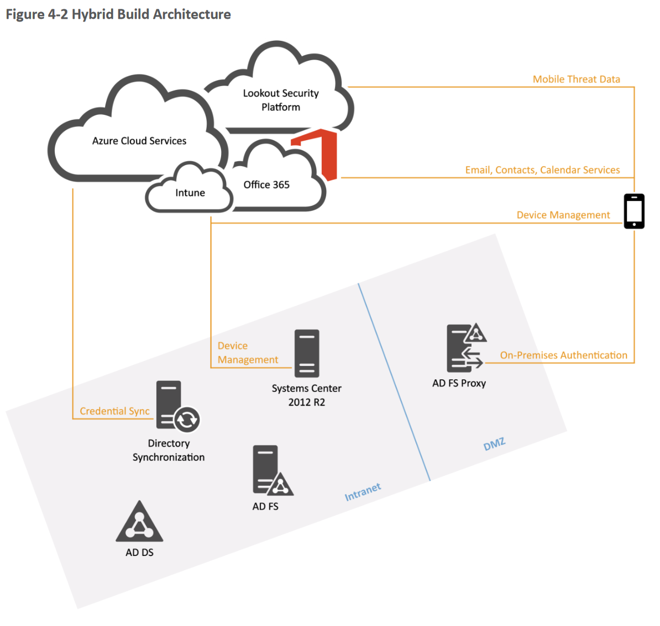
NIST Publications
NIST has published material on how to configure mobile devices to protect CUI.
A hybrid approach crushes mobile attack vectors.
A downside, however, is that this by default is not implemented through the iPhone. A security team must implement on a companies' own network.
Notes:
Now, digging even deeper into publications, I came across a guide that was published by NIST itself. This publication goes into detail explaining how to setup services such as Microsoft 365 securely by checking whether a device is on a compliance list. The downside is that since a user has to install the app, the setup and functionality is not automatic. A user will definitely need to study lengthy publications in order to setup more advanced controls by NIST. This approach is hybrid meaning that is uses the cloud, a network security infrastructure and proxies in other words a VPN (Virtual Private Network). So, while NIST has published extensively labeled material, it would likely be a challenge for an employee that doesn’t have an IT background. Unfortunately, this means that employees managing their own BYOD will have grave misconfiguration errors.

Slide 8
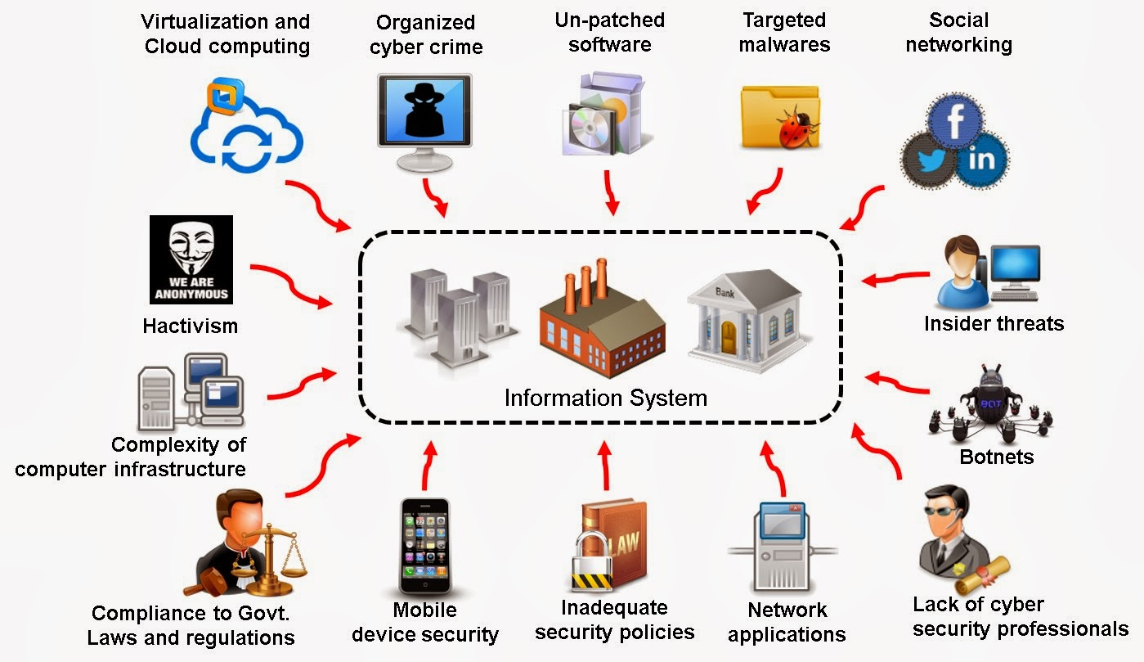

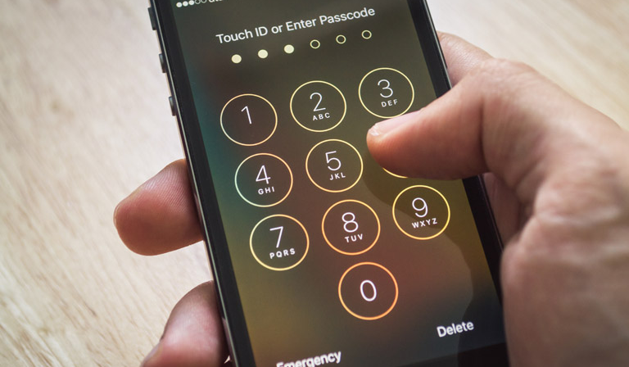
What Does This Mean?
By default, the iPhone is very secure.
With manually following NIST guidelines you can make the iPhone even more secure.
Without having an already secure network, the iPhone is dangerously unprotected from MITM and other attack vectors.
Notes:
Thus, what does all of this mean? Well, by default the iPhone is secure enough to be used in a BYOD workplace. Apple has made sure to secure the device for normal users, but for those who need even more security such as a pre-approved government Office 365 installation, you will need to configure this through NIST security publications. Also, if there is an already compromised network or the network in which the device sits is not configured correctly, there are still the possibility for CUI breaches. However, it can be assured that the integrity of an iPhone will remain supreme because device encryption is turned on automatically.

Slide 9

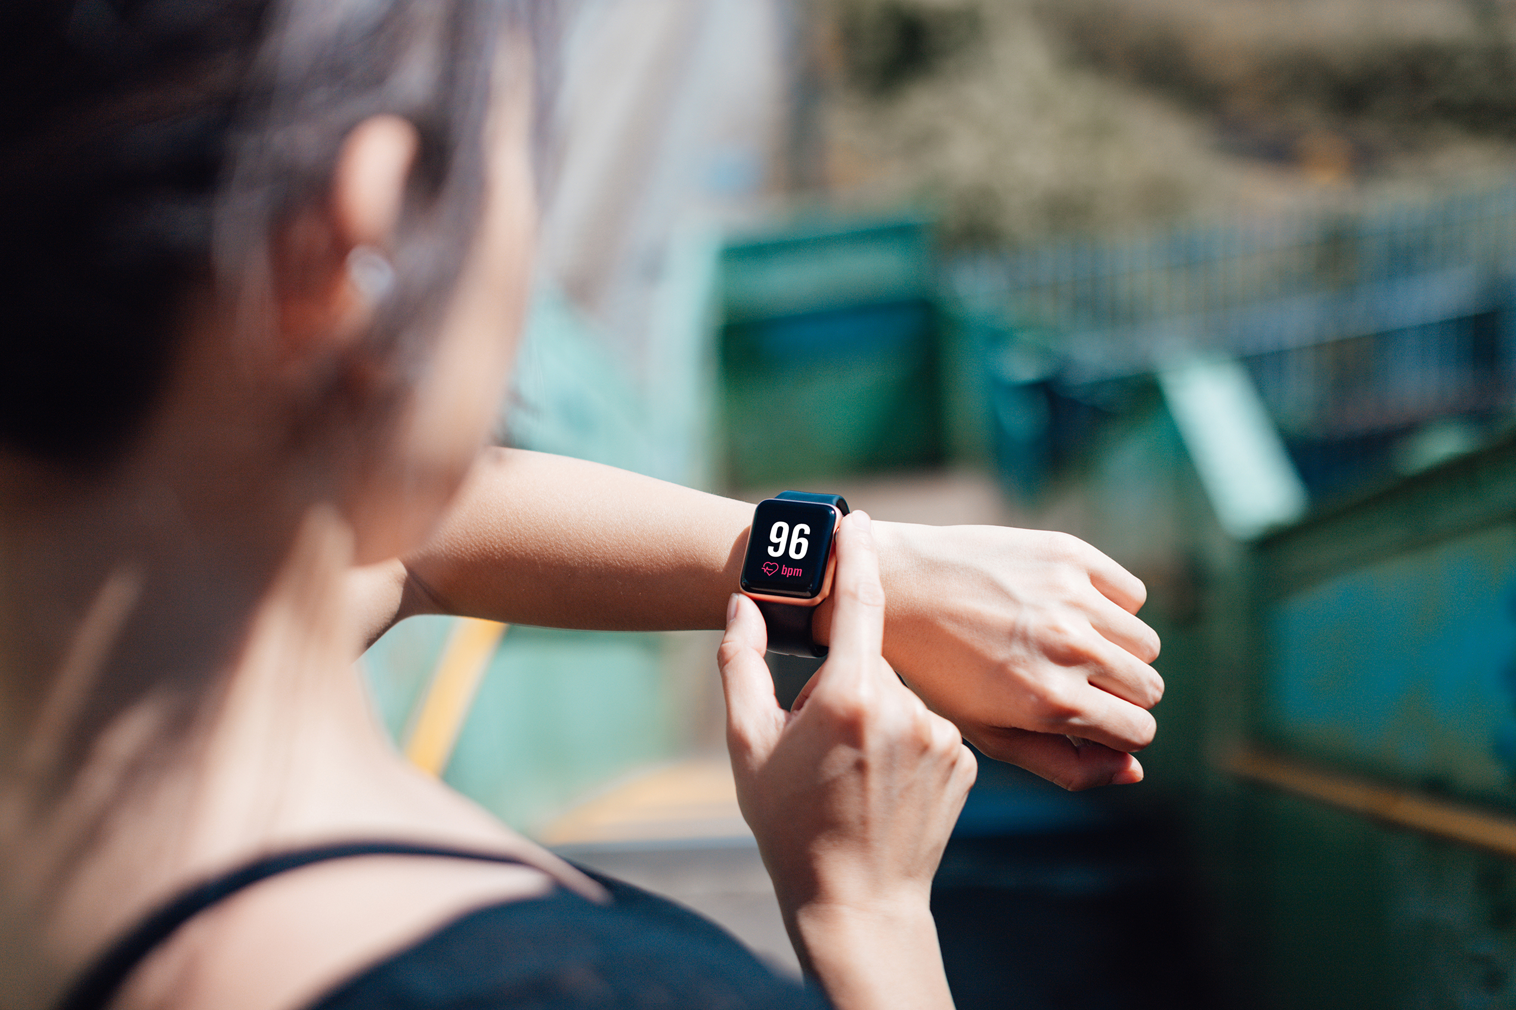

Other Apple Devices?
Mac comes with the same security features since it is an Apple, however, you are also allowed to install antivirus.
iPad and smart watches don’t have antivirus protection support yet.
Notes:
Now, for other Apple devices such as the Chromebook or iPad or smart watch, all the security features that are in NIST SP 800-179 are implemented in these devices too. These devices share the same platform and so will share the same security. The only downside to an iPad or a smart watch is that these devices use IOS (iPhone Operating System) meaning that these devices still can’t run an antivirus. The only device that can have antivirus is the Chromebook because that runs Mac OS which is a regular computer operating system.

Slide 10

Concerns/Questions
NIST security implementation.
Need IT background?
Lengthy publications.
Simple easy solution?
Notes:
One of my most major concerns for a BYOD network is that employees are essentially their own network IT security admins. If employees do not have the skills to maintain a secure device this puts the workplace in danger to data breaches. Moreover, even if an employee is skilled enough, it will take quite a long time to read through lengthy NIST publications to find the security controls to implement manually. Maybe there is a simple and easy solution, perhaps it pertains to using a different platform for a BYOD network?

Slide 11

Next Week?
I want to compare Apple vs Android’s security features.
Which is a better platform for DoD contractors or companies managing CUI.
Can the technologies scale?
Notes:
Thus, next week, I will be focusing on exploring Apple’s security vs Android’s security. I want to find which is the best platform to use for a BYOD network. Perhaps Android phones/devices are better for DoD contractors while Apple’s devices are better for regular companies' employees? I also lastly want to delve into whether these technologies can scale or if they are too much of a security risk.

Slide 12
References
Security certifications and compliance center. (n.d.). Retrieved June 14, 2022, from https://support.apple.com/guide/sccc/welcome/web
WP-content: A beginner's guide to wordpress' most important directory. (2021, November 18). Retrieved June 14, 2022, from https://www.malcare.com/blog/wp-content-uploads/
NIST Technical Series Publications. (n.d.). Retrieved June 14, 2022, from https://nvlpubs.nist.gov/nistpubs/SpecialPublications/NIST.SP.1800-4.pdf
Expert, W. P. S. (2022, January 9). WP-content/uploads hack - how to protect Wordpress Directory. Retrieved June 14, 2022, from https://secure.wphackedhelp.com/blog/wp-content-uploads/
Informatica e Ingegneria Online. (2022, May 25). Retrieved June 14, 2022, from https://vitolavecchia.altervista.org/
National Checklist Program. (n.d.). Retrieved June 14, 2022, from https://ncp.nist.gov/checklist/1011/download/7932
Please enable JavaScript. (n.d.). Retrieved June 14, 2022, from https://publicwww.com/websites/%221.bp.blogspot.com%22/14
The saga guide. (n.d.). Retrieved June 14, 2022, from https://www.saga.co.uk/contentlibrary/saga/publishing/verticals/guides/guide-to-buying-laptops-and-tablets/saga-guide_laptops-and-tablets.pdf?la=en
(n.d.). Retrieved June 14, 2022, from https://support.shutterstock.com/s/article/what-is-a-vectorized-image?language=en_US
IED Istituto Europeo di design. (n.d.). Retrieved June 14, 2022, from https://www.ied.edu/

